Slide 1
FOREST FIRE PREDICTION BY USING DATA SCIENCE
Presented By:
P.KUTTIKANNAN,
SRIVIDYA COLLEGE OF ENGINEERING & TECHNOLOGY
CIVIL ENGINEERING

Slide 2
OUTLINE
Problem Statement
Proposed System/Solution
System Development Approach
Algorithm & Deployment
Result
Conclusion
Future Scope
References

Slide 3
PROBLEM STATEMENT
Problem Statement: The current forest fire management approaches face several challenges:
Detection: Timely detection of forest fires remains a challenge due to vast and often inaccessible terrains. ng air pollution, habitat destruction, and loss of biodiversity.
To address these challenges, the following objectives are identifi
Response Time: Once detected, response time is critical. Delays in initiating firefighting efforts can lead to rapid fire spread and increased damage.
Resource Allocation: Allocating firefighting resources efficiently is essential but often constrained by budgetary limitations and competing priorities.
Community Safety: Protecting communities near forests from fire hazards requires proactive measures, including evacuation plans and public awareness campaigns.
Environmental Impact: Forest fires have significant environmental repercussions, includied:
Develop advanced technologies for early detection and monitoring of forest fires.
Improve coordination among firefighting agencies and stakeholders to enhance response times.
Implement data-driven approaches for optimizing resource allocation and deployment

Slide 4
PROPOSED SOLUTION
Public Awareness: Educate communities living near forests about fire safety measures, responsible land management practices, and the importance of reporting suspicious activities.
Vegetation Management: Implement controlled burns and selective logging to reduce fuel loads and create firebreaks.
Regulatory Measures: Enforce regulations on campfires, outdoor burning, and fireworks in fire-prone areas.
Infrastructure Planning: Incorporate fire-resistant materials and landscaping techniques in building and road construction near forests.
Remote Sensing: Utilize satellite imagery and aerial drones equipped with infrared sensors to detect heat signatures and smoke plumes.
Sensor Networks: Install ground-based sensor networks to monitor environmental conditions and detect signs of fire ignition.
Community Reporting: Encourage the public to report suspected fires promptly through hotlines or mobile apps.
Rapid Deployment: Mobilize firefighting crews, equipment, and aerial resources to the fire location as quickly as possible.
Fire Suppression Tactics: Employ a combination of techniques such as water drops from aircraft, backburning, and constructing fire lines to contain and extinguish the fire.

Slide 5
SYSTEM APPROACH
Prevention:
Fuel Management: Implement controlled burns, selective logging, and vegetation thinning to reduce fuel loads and create firebreaks.
Public Education: Educate communities on fire-safe practices, including campfire safety, proper disposal of cigarettes, and the risks of arson.
Regulations: Enforce regulations on outdoor burning, fireworks, and land use planning to minimize fire risks.
Infrastructure Planning: Incorporate fire-resistant materials and landscaping designs in construction projects near forests.
Preparedness:
Risk Assessment: Conduct risk assessments to identify high-risk areas and prioritize resources accordingly.
Community Engagement: Establish community fire prevention committees, conduct drills, and develop evacuation plans.
Training and Equipment: Provide training for firefighters in wildfire suppression techniques, use of equipment, and incident command systems. Ensure adequate firefighting resources are available, including vehicles, aircraft, and protective gear.
Early Warning Systems: Implement early warning systems using remote sensing technologies, such as satellite imagery and weather monitoring statement

Slide 6
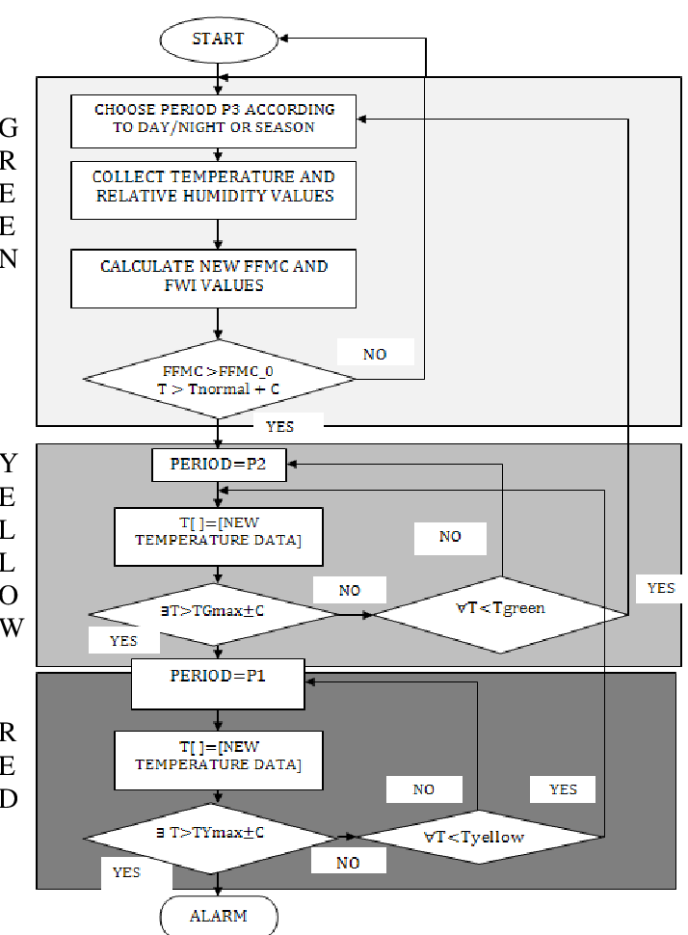
ALGORITHM & DEPLOYMENT

Slide 7
RESULT
Environmental Impact:
Habitat Destruction: Forest fires can lead to significant loss of vegetation, including trees, shrubs, and understory plants, altering ecosystems and habitats for wildlife.
Soil Degradation: Intense fires can damage soil structure, reduce fertility, and increase erosion, leading to long-term impacts on water quality and ecosystem health.
Air Quality: Smoke from forest fires can degrade air quality, posing health risks to humans and wildlife, especially those with respiratory conditions.
Loss of Biodiversity: The destruction of vegetation and habitat fragmentation caused by fires can result in the loss of plant and animal species, affecting biodiversity.
Economic Consequences:
Property Damage: Forest fires can damage homes, infrastructure, and agricultural lands, resulting in significant economic losses for individuals, businesses, and government

Slide 8
CONCLUSION
Save your chat history, share chats, and personalize your experience.
In conclusion, forest fires represent a complex and significant challenge with far-reaching consequences for ecosystems, economies, and communities. Addressing this issue requires a multifaceted approach that encompasses prevention, preparedness, response, and recovery efforts.
Prevention measures such as fuel management, public education, and regulatory enforcement aim to reduce the likelihood of fires igniting and spreading. Early detection systems and effective communication networks enhance preparedness by enabling rapid response to emerging fire threats. When fires do occur, coordinated efforts involving firefighting crews, resources allocation, and evacuation plans are essential to minimize damage to lives, property, and the environment.
The aftermath of a forest fire demands thoughtful and sustained recovery efforts to restore ecosystems, support affected communities, and mitigate long-term impacts. This includes rehabilitation of habitats, assessment of economic losses, and provision of social and psychological support for those affected. Collaboration among government agencies, non-profit organizations, communities, and other stakeholders is critical throughout all stages of fire management to ensure a coordinated and effective response.
While forest fires present significant challenges, they also underscore the importance of proactive measures, innovation, and resilience in addressing natural disasters. By implementing comprehensive strategies that integrate prevention, preparedness, response, and recovery, stakeholders can mitigate the impacts of forest fires and build more resilient communities and ecosystems in the face of future challenges.

Slide 9
FUTURE SCOPE
The future scope of forest fire management encompasses various avenues for improvement and innovation, driven by advancements in technology, research, and collaborative efforts. Here are some potential areas of development:
Predictive Modeling: Utilizing advanced data analytics, machine learning, and remote sensing technologies to develop more accurate and reliable predictive models for forecasting fire behavior, ignition probability, and potential spread patterns. This can help authorities prioritize resources and implement preemptive measures in high-risk areas.
Early Detection Systems: Enhancing early detection capabilities through the integration of satellite imagery, drones, sensor networks, and artificial intelligence algorithms. Real-time monitoring and automated alert systems can enable rapid response to emerging fire threats, reducing the risk of large-scale wildfires.
Climate Change Adaptation: Recognizing the influence of climate change on fire frequency, intensity, and seasonality, and integrating climate adaptation strategies into forest fire management plans. This may include ecosystem restoration, land-use planning, and sustainable forest management practices to mitigate the impacts of climate-driven changes.

Slide 10
REFERENCES
Scientific Journals:
"Journal of Applied Fire Science"
"International Journal of Wildland Fire"
"Fire Ecology"
"Forest Ecology and Management"
"Natural Hazards Review"
Government Agencies:
United States Forest Service (USFS)
National Interagency Fire Center (NIFC)
National Park Service (NPS)
Bureau of Land Management (BLM)
Forestry Departments or Ministries in various countries (e.g., US Department of Agriculture, Canadian Forest Service, Australian Department of Agriculture, Water and the Environment)
Academic Institutions:
Research papers and reports from universities with forestry, ecology, or environmental science departments.
Websites of research centers or institutes focusing on fire ecology, wildfire management, or related top

Slide 11
THANK YOU

